Slide 1

Government College of Engineering, Karad (An Autonomous Institute of Government of Maharashtra) Department of Information Technology
Third Year B.Tech. [Winter-2023]
Mini Project
Title:Gas Leakage Detection System Using IoT.
Name of Guide: | Group No: | Group Members:
Prof. N.M. Mule | 32 | Sushant Chougule [21141260] Virendra Jopale [21141261]

Slide 2
CONTENTS:
1 | Introduction
2 | Definition of the Problem
3 | Existing System
4 | Proposed Methodology
5 6 7 8 | Result Literature Survey Conclusion References

Slide 3
INTRODUCTION
Working Principal of Gas and Smoke Detector
To design and construct Gas and Smoke Detector using Arduino Uno and sensors

Slide 4
DEFINITION OF THE PROBLEM
Gas leaks in homes and industries are a serious and potentially life-threatening issue.
These leaks can involve a variety of gases, including natural gas, propane, methane, and industrial gases.
Gas leaks can pose significant dangers and consequences, both in residential and industrial area.
Dangers of Gas Leaks : Fire and Explosion Hazard, Health Risks, Environmental Impact, Property Damage, Loss of Life, etc.
Consequences of Gas Leaks : Injury and Death, Property Destruction, Environmental Damage, Economic Loss, Community Impact, etc.

Slide 5

EXISTING SYSTEM
Different Types of existing Gas Detector Models present :
Electrochemical sensors
Catalytic sensors
Infrared sensors
Photoionization sensors

Slide 6
PROPOSED METHODOLOGY
Power Supply
Arduino Uno
LCD Display
MQ Sensor
NO
YES
GSM Module
Exhaust Fan
Flow Chart For Gas Leakage Detector System

Slide 7
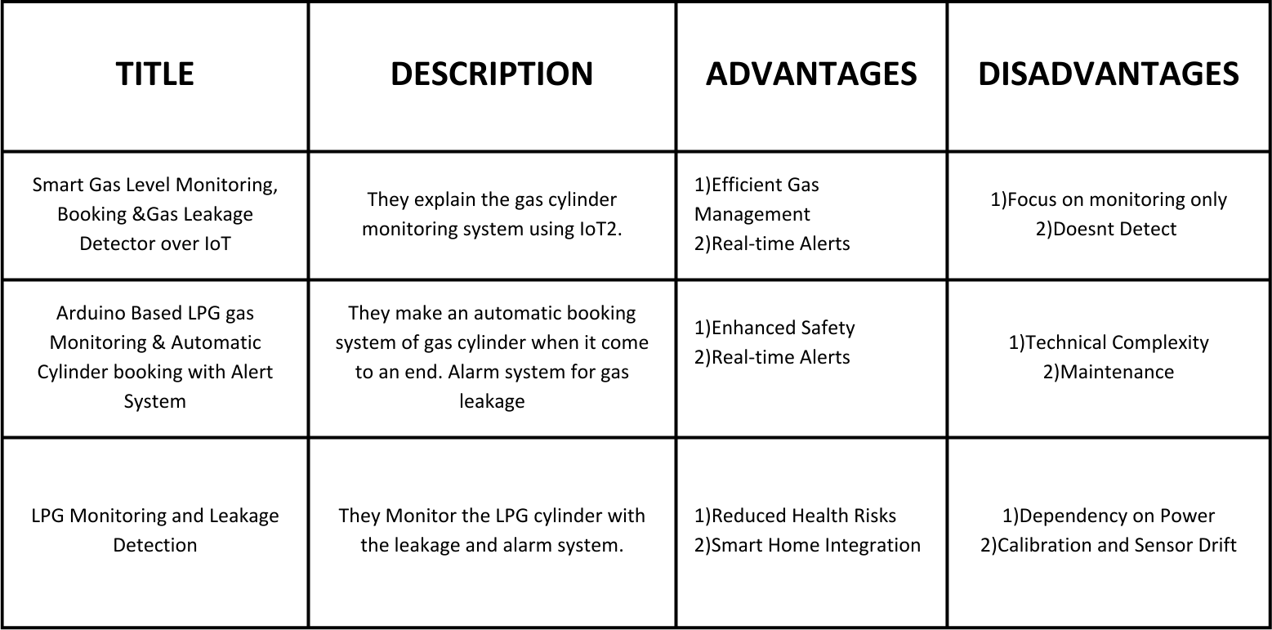
LITERATURE SURVEY

Slide 8
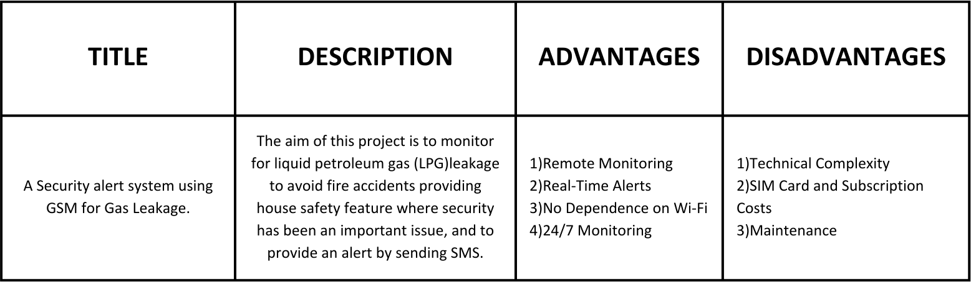
LITERATURE SURVEY

Slide 9
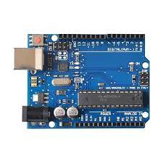
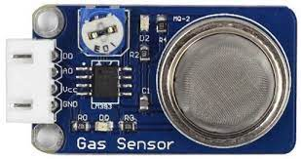
SENSORS AND MODULS
MQ2 Sensor –
The MQ-2 sensor is a gas sensor module that detects variety of gases and fumes.
Gases - LPG (liquefied petroleum gas), butane, propane, methane, alcohol, hydrogen, and smoke
ARDUINO UNO –
The Arduino Uno is a microcontroller board.
It is based on the ATmega328P microcontroller and provides a range of functionalities and features, making it versatile for a wide range of applications.

Slide 10
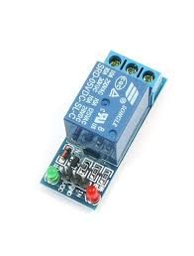
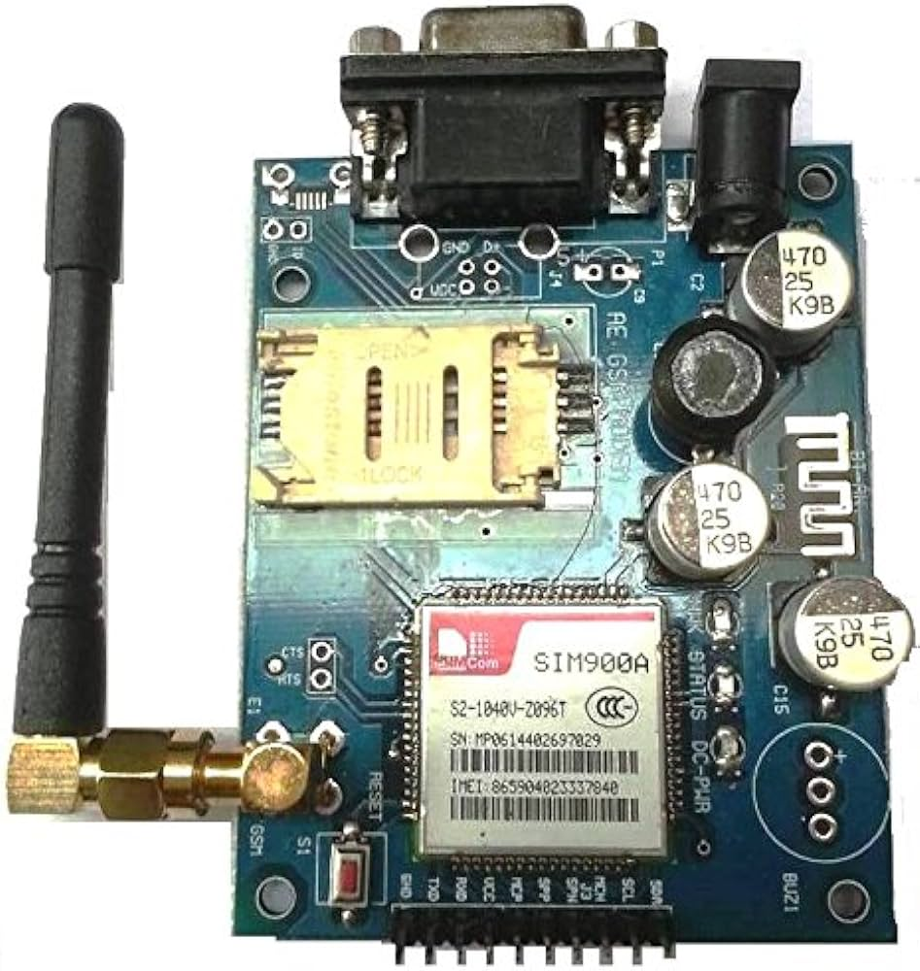
GSM MODULE (SIM900A) –
The SIM900A is a GSM/GPRS (Global System for Mobile Communications/General Packet Radio Service) module that provides the ability to connect to cellular networks and perform various communication tasks.
RELAY MODULE –
A relay module is an electronic device that consists of one or more relays (electromechanical or solid-state) and associated circuitry.
It is commonly used to control high-power or high-voltage electrical devices with a low-power electronic control signal.

Slide 11
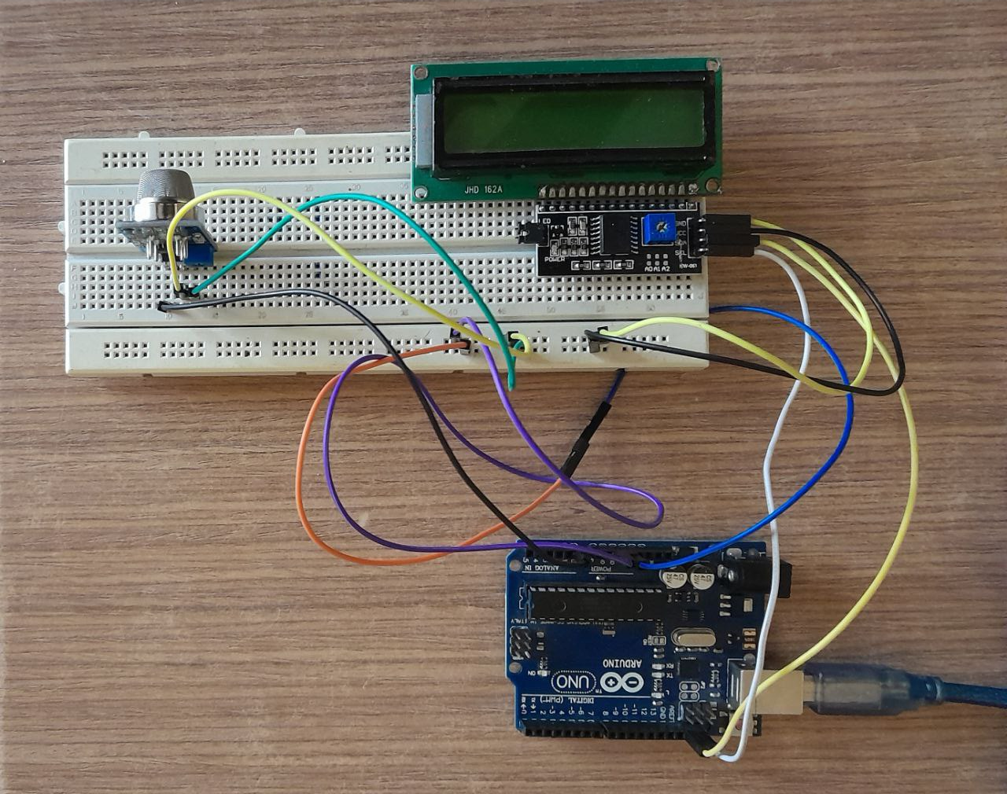
RESULT
Arduino Uno interfacing with MQ2 sensor and LED Dispaly

Slide 12
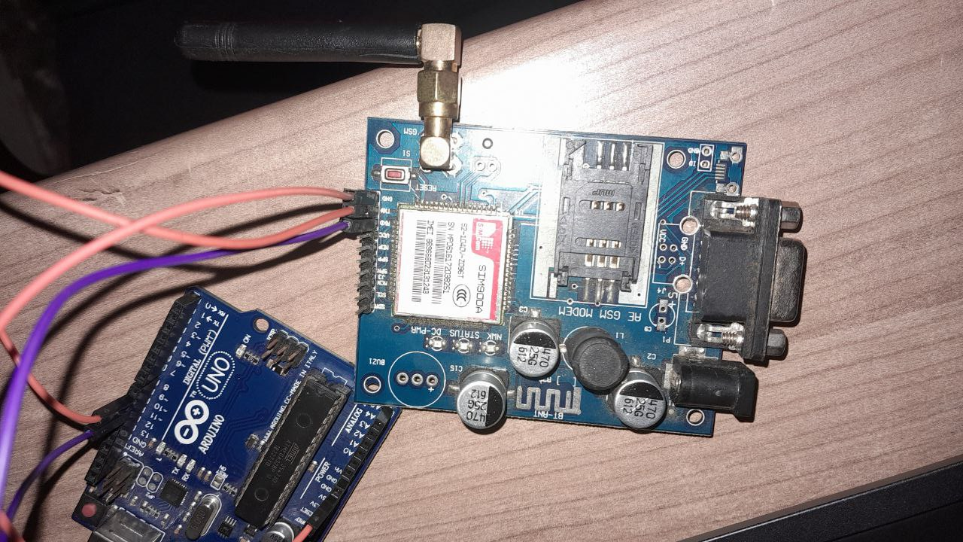
GSM SIM900A interfacing with Arduino

Slide 13
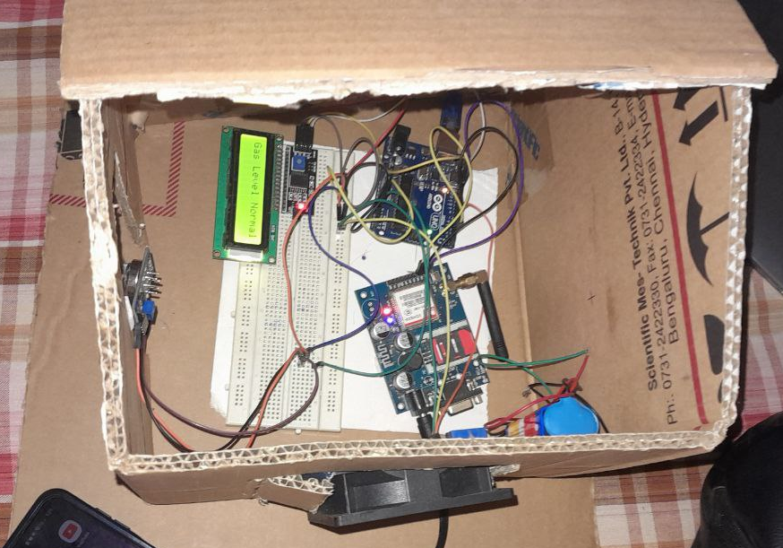

Slide 14
CONCLUSION
A Gas Leakage Detection System project aims to enhance safety in various environments where the presence of gas leaks can pose serious risks.
This project typically involves the use of gas sensors, microcontrollers, and alert mechanisms to detect and respond to gas leaks effectively.
This project serves as a critical solution for enhancing safety and environmental protection.
It has the potential to save lives, prevent accidents, and minimize damage in the face of gas leaks. Whether implemented in residential, commercial, or industrial settings, the project showcases the value of technology in addressing real-world safety concerns.

Slide 15
REFERENCES
Arpitha, T and Kiran, Divya and Gupta, VSN Sitaram and Duraiswamy, Punithavath, FPGA-GSM based gas leakage detection system, India Conference (INDICON), 2016 IEEE Annual.
Amsaveni, M and Anurupa, A and Preetha, RS Anu and Malarvizhi, C and Gunasekaran, Mr Gsm based LPG leakage detection and controlling system, The International Journal Of Engineering And Science (IJES) ISSN (e) 2015.
Kesavan, G., P. Sanjeevi, and P. Viswanathan A 24 hour IoT framework for monitoring and managing home automation, Inventive Computation Technologies (ICICT), International Conference on. Vol. 1. IEEE, 2016.
Hanwei Electronics Co. Ltd., Data sheet MQ-2 sensor, 2008.

Slide 16
THANK YOU !

